Slide 2
Welcome to First Grade!

Slide 3
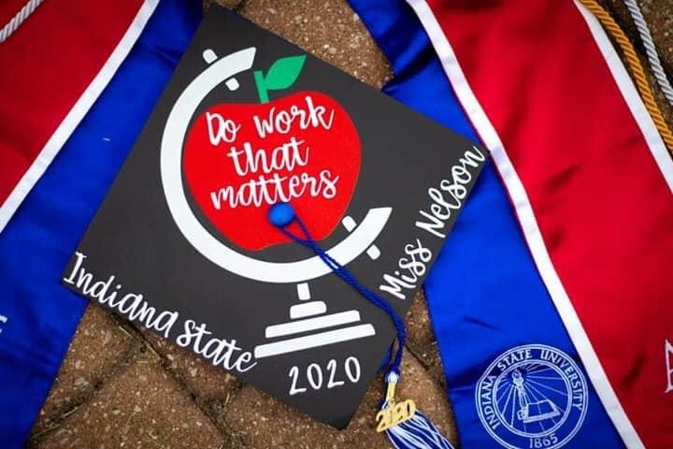
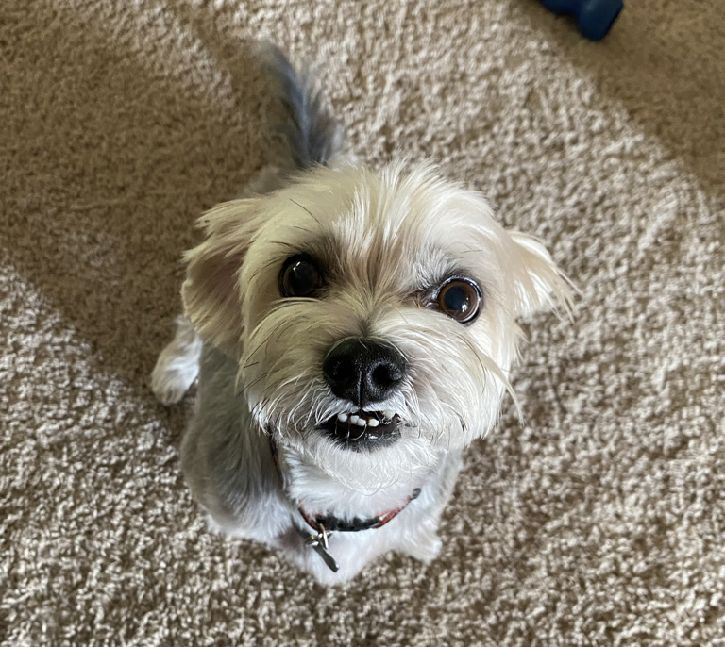
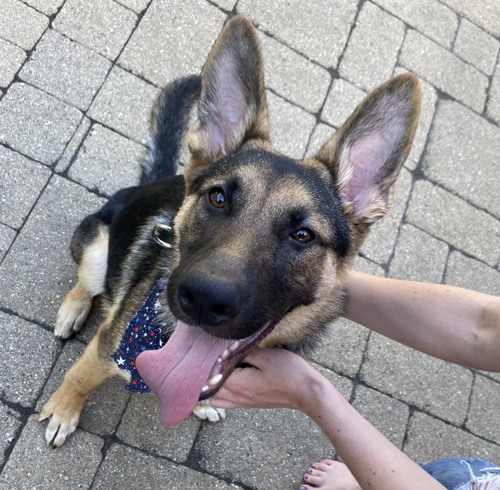
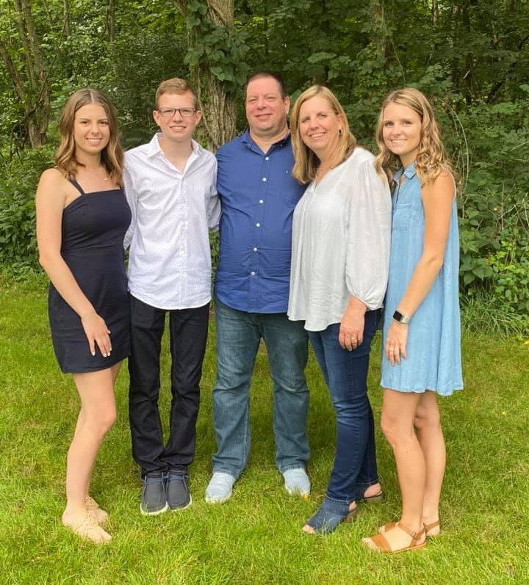
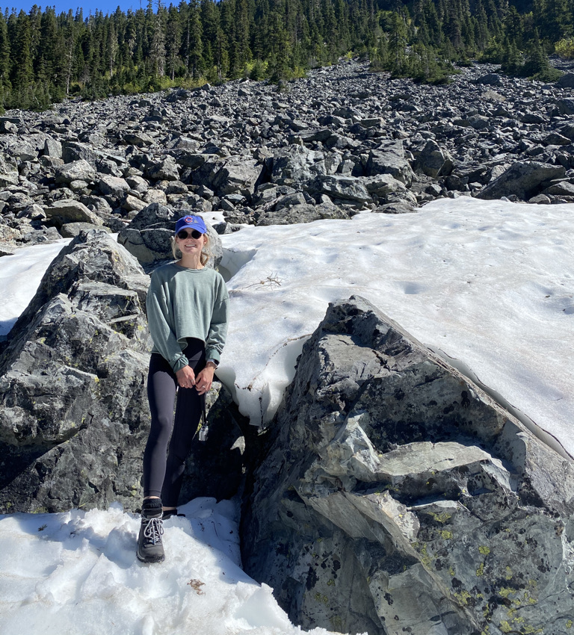
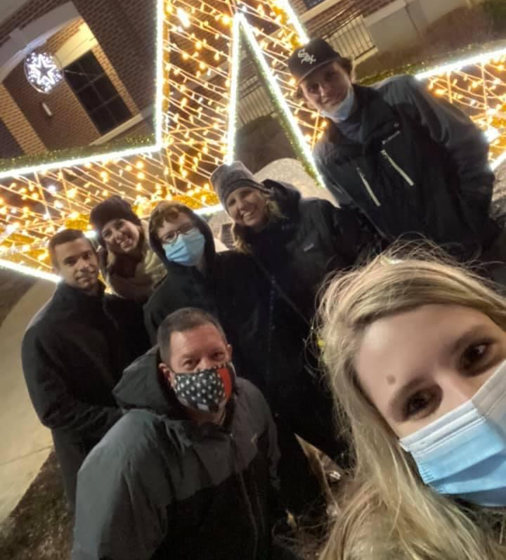
About Me!

Slide 4
Contact Information/Communication
A newsletter will be sent home every Friday for the following week. These will be sent home via e-mail.
The best way to reach me is through email knelson@nlsd122.org.
Seesaw can also be used to send quick messages.
Please make sure to check your email regularly for photos and reminders!

Slide 5
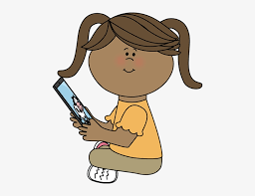
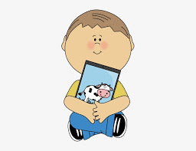
Tech Help
Email the NLSD Tech Support at tech-help@nlsd122.org or call the Haines office at (815) 485-2115.

Slide 6
What should I connect to?
Class Dojo: Sign up information was sent home on the first day of school. This is an important platform used for messages, pictures, videos, and daily behavior updates.
Seesaw: Codes were sent home. Students have been connected to their school account, but parents need to connect using the Family Access Code so work can be viewed and announcements received.
Raz-kids: Log-in information and cards were sent home today. This is a great app/site that your child can listen and read books on.

Slide 7
Specials
We alternate between blue/white days. These days will be indicated in the weekly newsletter.
White Days- Art/Music (Music and art switches every 6 weeks)
Blue Days- P.E. (Wear gym shoes!)
Our special time is from 10:55-11:25 daily.

Slide 8
Library
Our library time is: Mondays 10:00-10:30
Students must return their book(s) prior to our time in order to check out more materials.
Students will check out 1 book at the beginning of the year and will check out 2 books closer to the end of the year.
Students will need headphones daily for iPad use.

Slide 9
Lunch/Snack
Snack: 11:30
Recess: 12:45-1:00
Lunch: 1:00-1:20
*Please send a water bottle with your child daily for them to keep at their desks and refill throughout the day!

Slide 10
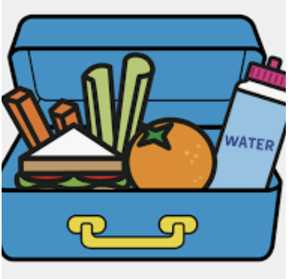
Lunch Orders
Please visit the Haines website if your child will be signing up for school lunch.
Lunches need to be ordered weekly.
https://www.nlsd122.org/c/index.php/schools/haines/lunch/lunch-menu

Slide 11
Classroom Management
Class Dojo is a behavior management tool that allows me to assign and take away points to each child on a daily basis.
We will be starting over with points every week.
Each week there will be a point total that will be set as an individual goal. If a student reaches that goal at the end of the week, they will get the reward set by the teacher.
You will be able to view points, pictures, and messages via the Class Dojo app.

Slide 12
Class Dojo
Parents will get to see what their child earned points for and what their child may need improvement in.
When a student earns a point it will say what they earned the point for.
When a child loses a point it will say why they lost the point.
Our Class Dojo system also aligns with CHAMPS, which are behavior expectations throughout the entire school.
Please make sure you get connected to your student’s Class Dojo as soon as possible!

Slide 13
CHAMPS
CHAMPs is a district-wide behavior system that students follow.
These expectations ensure students know what behavior is expected of them during various activities throughout the day.

Slide 14
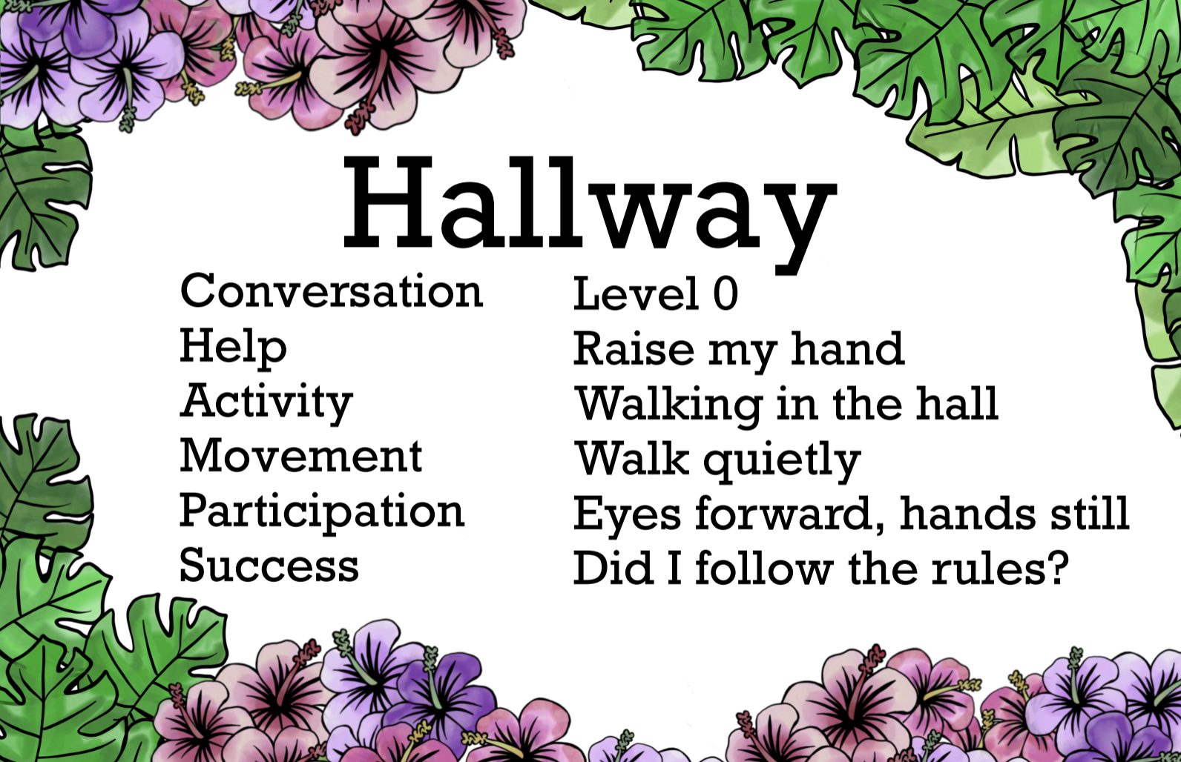

Slide 15
Math Homework
Students will complete a Math Home Link (worksheet) every Monday-Thursday.
Home Links will be reviewed the next day in class, so please make sure they are brought to school in take-home folders daily.
If you misplace a Home Link, you can find extra copies on the Everyday Math website.

Slide 16
Seesaw
Students should not be completing work on Seesaw after school hours unless directed to by the teacher.
Feel free to check-in through the Family Access code to view your child’s work!

Slide 17
Ready Gen Reading Curriculum
We are excited to be teaching Ready Gen again this year.
This is a rigorous program that involves reading, writing, spelling, and grammar.
The program involves much more writing and students will be exposed to the different types of writing such as narrative, opinion, and informative.
This program has sight word lists to practice.
Ready Gen uses a spelling/phonics program that focuses on spelling patterns.
Students will be receiving lists that should be practiced nightly. I will let you know each week which lesson numbers you should be practicing.
It is important to read the weekly newsletter to stay up-to-date on the pacing of the program.

Slide 18
Ready Gen Reading Curriculum
Spelling tests will occur through out the unit.
There will no longer be an every Friday spelling test.
I will give you a notice a few days in advance as to when our spelling test will be.
In the meantime, the best thing you can do at home is practice the words nightly.
Students will also be practicing the words at school during our word work time.
The Ready Gen approach to teaching writing to the students is an I Do, We Do, You Do. Much modeling will allow them success when they work on their writing independently.

Slide 19
What should I practice with my child?
Your child should not be on SeeSaw after school hours.
Math Homelinks
Touch Points
Sight Word lists
Spelling Words
Writing their first and last name
Practice reading 10 minutes every night
Razkids
Books from your home or library

Slide 20
Word Worms
Worms Worms is our motivating program to help first graders master their sight words.
Information on this program will be coming home soon!
Please make sure your child is practicing this kindergarten list (located on my website) for when we start testing!

Slide 21
Transportation
If your child will be getting home a different way than normal, please send in a note with them. We ask that if transportation changes during the day, please contact the office instead of using e-mail or Class Dojo.

Slide 22
Website
My website has all of the information from tonight and more for you to check-out!

Slide 23
Thanks for coming!
It’s going to be a great year!

