Slide 1
THE CIVIL WAR
1864 - 1865

Slide 2
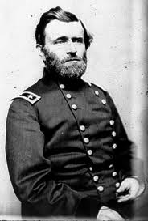
“Total War”
When General Ulysses S. Grant became commander of the Union forces, a new type of combat was created. Total War is the phrase used to describe Grant’s tactic of winning the war.

Slide 3
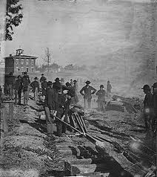
“Total War”
In the past, only soldiers were involved in wars. In “total war”, however, everyone was affected as the Union army destroyed food and equipment that might be useful to the enemy.

Slide 4
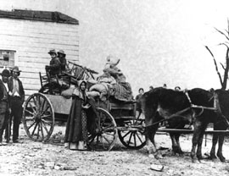
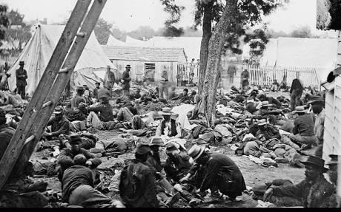
“Total War”
As a result of the Union’s decision to wage “total war”, civilians suffered the same hardships as soldiers.

Slide 5
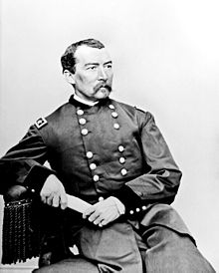
Sheridan in the Shenandoah
General Grant wanted to end the war by destroying the South’s ability fight.
Grant sent General Philip Sheridan and his troops into the fertile farmland of Virginia’s Shenandoah Valley.
General Sheridan was ordered to destroy everything!
In the summer and fall of 1864, General Sheridan marched through the valley destroying farms and livestock.

Slide 6
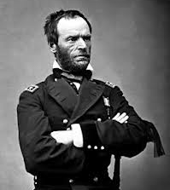
William Tecumseh Sherman
General Grant also ordered General William Tecumseh Sherman to march and capture Atlanta, Georgia, and then march to the Atlantic coast.

Slide 7
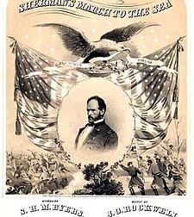
General Sherman’s “March”
Like General Sheridan, General Sherman had orders to destroy everything useful to the South.

Slide 8
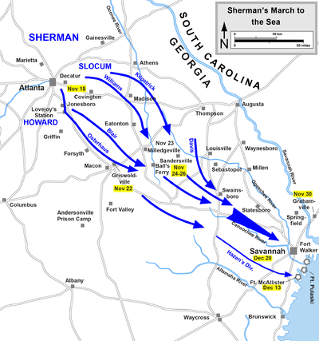
General Sherman’s “March”
General Sherman and his troops captured Atlanta, Georgia in September 1864. They burned the city in November when Sherman began his “march to the sea”.

Slide 9
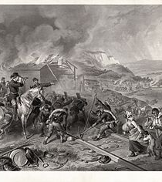
General Sherman’s March
General Sherman and his troops traveled from Georgia to South Carolina ripping up railroads.
They built bonfires with the barns, bridges, homes, factories, and public buildings they destroyed.

Slide 10
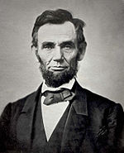
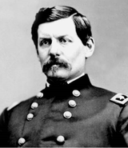
Lincoln Runs for Re-election
In 1864, Lincoln ran for re-election (Republican candidate).
The Democrats nominated George B. McClellan to oppose Lincoln in the election.

Slide 11
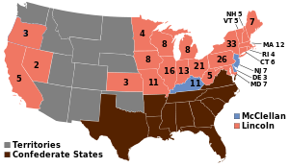
President Lincoln is Re-elected
At first, Lincoln’s defeat in the election seemed “extremely probable”.
However, with General Sheridan’s success in the Shenandoah and General Sherman’s taking of Atlanta in September, the north rallied around Lincoln.
In the election of 1864 (November), the vote was close, but Lincoln remained President.

Slide 12
The Fall of the Confederacy
Transportation problems and successful blockades caused severe shortages of food and supplies in the South.
Starving soldiers began to desert General Lee’s forces.

Slide 13
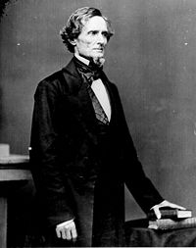
The Fall of the Confederacy
In February 1865, Confederate President Jefferson Davis agreed to send delegates to a peace conference with President Lincoln.
However, President Davis insisted on Lincoln’s recognition of the South as a separate country.

Slide 14
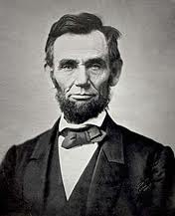
The Fall of the Confederacy
President Lincoln refused to recognize the South as a separate country and the conference ended.

Slide 15
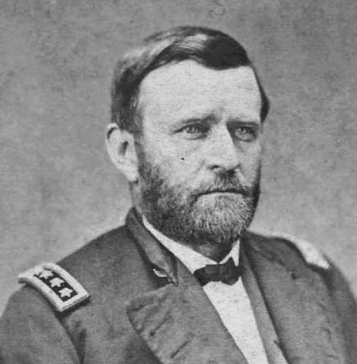
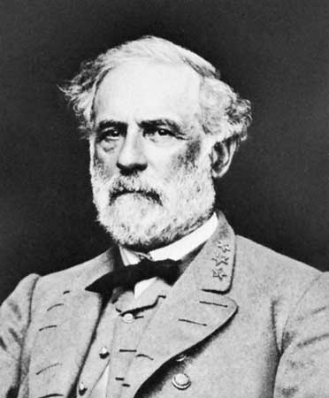
The Fall of the Confederacy
In March 1865, General Grant attacked General Lee’s forces at Petersburg, near Richmond, Virginia. Here, Grant kept Lee under siege for 9 months.

Slide 16
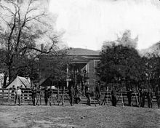
The Fall of the Confederacy
On April 2, 1865 General Lee and his men evacuated Richmond, and headed to a small town called Appomattox Courthouse.

Slide 17
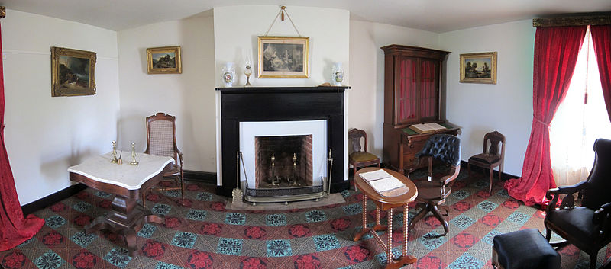
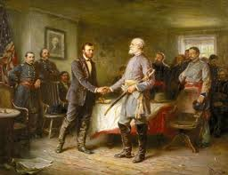
The Fall of the Confederacy
In Appomattox Courthouse, one week later, General Lee and his men were trapped by Union troops.
Lee knew if he kept fighting his men would be slaughtered.
On April 9, 1865, General Lee surrendered to General Grant at Appomattox Courthouse.

Slide 18
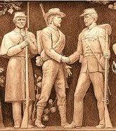
The Fall of the Confederacy
As the Confederates surrendered, the Union forces began to cheer.
General Grant ordered the men to be silent, saying “The war is over. The Rebels are our countrymen again.”

Slide 19
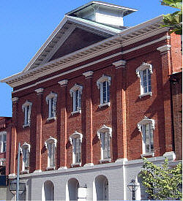
The Assassination of President Lincoln
On April 14, 1865, as President Lincoln was watching a performance at Ford’s Theater, in Washington, D.C., he was shot by John Wilkes Booth.

Slide 20
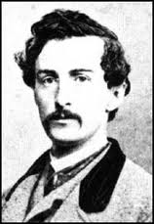
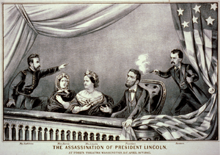
The Assassination of President Lincoln
Booth was obsessed with avenging the Confederate’s defeat in the war. President Lincoln died the next morning.

Slide 21
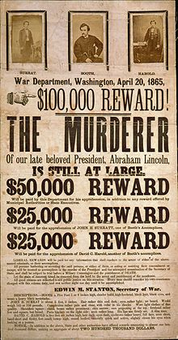
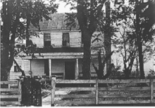
The Assassination of President Lincoln
11 days after the assassination, John Wilkes Booth was cornered in a barn and was killed by a Union soldier.

Slide 22
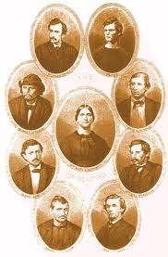
The Assassination of President Lincoln
9 other people were involved in the assassination of Lincoln:
4 were hanged
4 were imprisoned
1 was acquitted

Slide 23
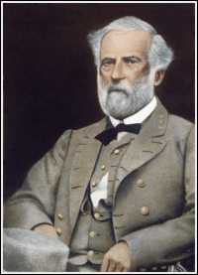
General Robert E. Lee
General Lee became a “civilian”.
He was never allowed to serve in the army or hold any position of power within the government of the United States.
General Lee died October 12, 1870 (63 years old).
January 19th – General Lee’s birthday is a legal holiday in many southern states.

