Slide 1
GEOGRAPHY
The study of where people, places, and things are located and how they relate to each other.

Slide 2
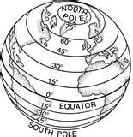
LATITUDE
Measures distances north or south of the equator.

Slide 3
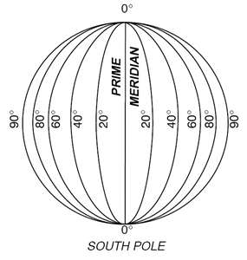
LONGITUDE
Measures distances east or west of the prime meridian.

Slide 4
PRIME MERIDIAN
Imaginary line which divides the Earth into eastern & western hemispheres.

Slide 5
Five Themes of Geography
Location
Place
Interaction
Movement
Region

Slide 6
Five Themes of Geography
http://www.brainpop.com/socialstudies/geography/geographythemes

Slide 7
Location
The position on the Earth’s surface.

Slide 8
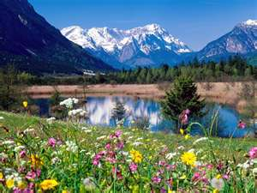
PLACE
Physical and human characteristics of a location.

Slide 9
Place
Physical: Landforms, climate, soil and animal life.
Human: People’s way of life
activities
transportation
religion
languages

Slide 10
Human Environment Interaction
How people interact with the environment & adapt to their surroundings.

Slide 11
Movement
Migration – people traveling from one place to another looking for food, work, a better life, etc.
Trade – movement of goods between areas.
Ideas – when an idea spreads from place to place.
Interdependence – depending on other countries for goods and resources.

Slide 12
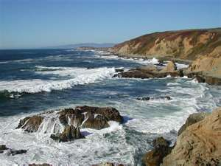
Region
An area defined by common characteristics.
(Landforms, climate, etc.)

