Slide 1
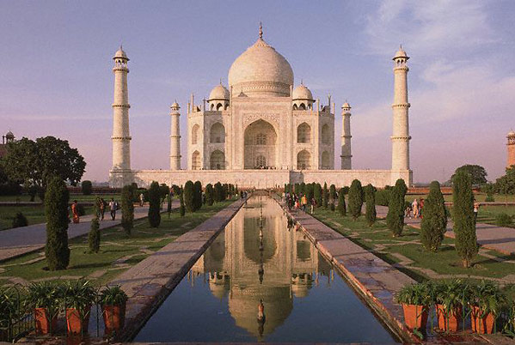
INDIA

Slide 2
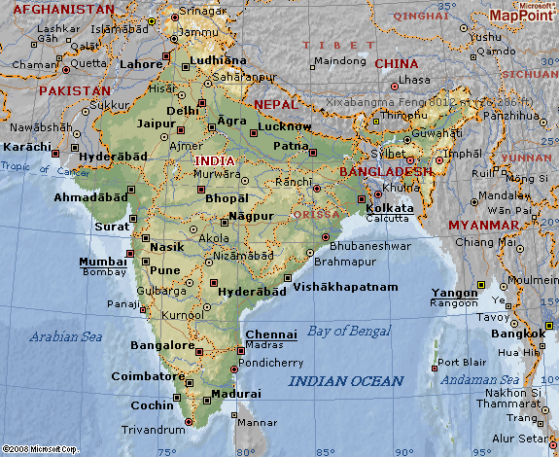
Where is India???
India is located in South Asia on a subcontinent
Subcontinent – a large landmass that is smaller than a continent

Slide 3
3 Major Land Regions
1. Himalayas – tallest mountain system in the world; run along the country’s northern border Himalayan Mountains
2. Indo- Gangetic (Gangetic Plain)- Excellent farmland
South of the Himalayas, it stretches about 1,500 miles across northern India
Half of the population lives in this region
3. Deccan Plateau – forms most of the triangle shaped peninsula; surrounded by many hills/mountains and valleys

Slide 4
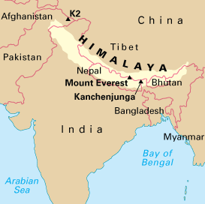
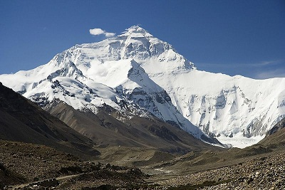

Slide 5
Climate
Climate varies by region and season
Cool season (October - February)
Hot season (March – June)
Rainy season (June – September)
India has a variety of climate types ranging from snow and glaciers to hot and dry deserts

Slide 6
Monsoons
Monsoon = Seasonal wind that dominates the climate of South Asia
Brings moist air from the Indian Ocean in the summer
In the winter, the wind brings dry air from the Asian interior
Summer Monsoon is very important to India’s agriculture. Farmers depend on the rain for their crops.
If summer rains come too soon or too late, food production suffers

Slide 7
Taj Mahal
A famous monument located in Agra, India

Slide 8
Government
India’s government is a Parliamentary Democracy (based on British form of govt.)
President (little power)
Council of Minister (political party)
Prime Minister (leader of political party)
The Prime Minister is similar to the President of the United States

Slide 9
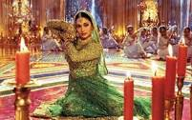
Entertainment – Bollywood
The motion picture industry in India is one of the world’s largest, larger than Hollywood. It first became very popular because many didn’t own t.v.’s so going to the show was a popular form of entertainment. Most are musicals.

Slide 10
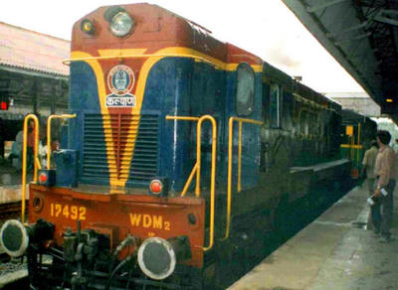
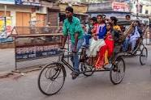
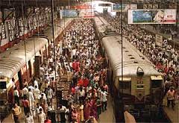
Transportation
Railways – most common
Bikes
Horse carriages & rickshaws
Automobiles (typically for those
considered wealthy.)

Slide 11
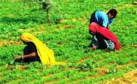
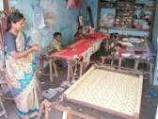
Economy
India’s currency is called rupee
Farming is the largest part of India’s economy
About 60% of India’s population works as a farmer
Cottage Industries – work done at home (clothes, rugs, arts/crafts, etc.)

Slide 12
Resources
Fertile Farmlands are important to the economy
Majority of the population works in agriculture
The country produces cash crops for exports (cotton, spices, tea)
Mineral Resources: Iron ore, bauxite, uranium, and coal
India has some oil reserves, but not enough to sustain the country’s needs
Forests and Wildlife

Slide 13
Population
Population 2nd largest population in the world
40% are under the age of 14
This has lead to serious overcrowding and immense pressure on the economy and in schools
Many languages spoken
School overcrowded
Literacy rates are low
Drop out rate is still high
More boys attend school than girls
Most schools teach 3 languages = Hindi, English, local language

Slide 14
Calcutta, India (Eastern Coast)

Slide 15
Calcutta, India

Slide 16
Mumbai (Bombay), India

