Slide 1
Road to Civil War

Slide 2
Who was Nat Turner? What eventually happened to him?
He was an African American Preacher who led a revolt in Virginiain which 57 white people were killed.
He was hung.

Slide 3
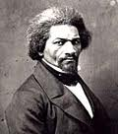
What is an abolitionist?
A person who wanted to end slavery in the United States.
Who was the best-known African American abolitionist?
Frederick Douglass
Who was the most outspoken white abolitionist?
William Lloyd Garrison

Slide 4
The secret network of abolitionists that secretly helped runaway slaves escape to freedom in the North was the underground railroad.
Harriet Tubman

Slide 5
In 1819, how many states were there?
22
How many of these were “free” states?
11
How many of these were “slave” states?
11

Slide 6
Why was the admission of Missouri, as a state, such a debated topic?
Because to admit Missouri would offset the balance of the power in the Senate (12 – 11).
What did Henry Clay propose in the
Missouri Compromise?
To admit Missouri as a “slave” state, and
To admit Maine as a “free” state.

Slide 7
Why was Henry Clay’s idea such a good one?
The balance of power in the Senate would remain even:
12 Free States
12 Slave States

Slide 8
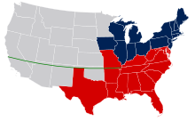
As part of the Missouri Compromise:
Where was slavery permitted?
In lands south of Missouri
Where was it banned?
In lands north of Missouri

Slide 9
What is sectionalism?
Loyalty to a state, or section of land, rather than to the country as a whole.
What does popular sovereignty mean?
Control by the people / Voters decide

Slide 10
What new political party formed in 1848, out of the issue of slavery?

Slide 11
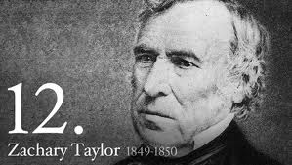
Election of 1848
Free Soil Party candidate - Martin Van Buren
Democrat candidate - Lewis Cass
Whig candidate - Zachary Taylor
Who won the election?
Zachary Taylor

Slide 12
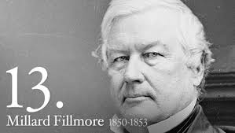
President Taylor died in office in 1850. Who became the next President of the United States?
Millard Fillmore

Slide 13
The Compromise of 1850
California entered the United States as a “free” state.
This “upset” the balance of power in the Senate (13-12)
The rest of the Mexican Cession was divided into territories – in these territories the voters would decide if slavery was going to be allowed.
Popular Sovereignty
The overseas slave trade ended. However, Congress declared that it didn’t have the power to ban the slave trade between the states.
The Fugitive Slave Law was passed.

Slide 14
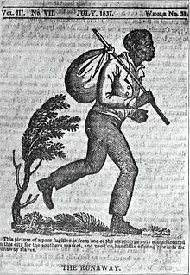
What was a fugitive slave?
Slaves who managed to free themselves from their owners (runaways)

Slide 15
What did the Fugitive Slave Law of 1850 say?
It required ALL citizens to help catch, and return to the South, runaway slaves.
Slave owners were permitted to travel into “free” states to capture runaway slaves.

Slide 16
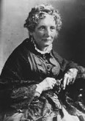
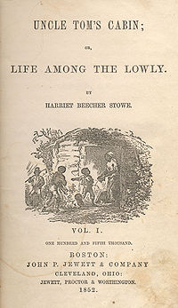
What is Harriet Beecher Stowe famous for?
She is the author of Uncle Tom’s Cabin -
Uncle Tom's Cabin (1852) was a depiction of life for African-Americans under slavery; it reached millions as a novel and play, and became influential in the United States. It energized anti-slavery forces in the American North, while provoking widespread anger in the South.

Slide 17
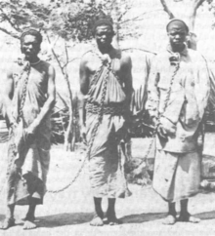
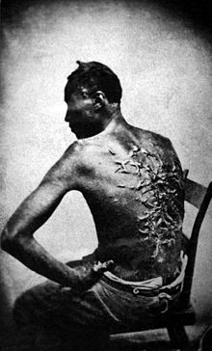

Slide 18
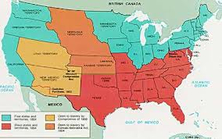
What was the Kansas-Nebraska Act?
It created the territories of Kansas and Nebraska and stated that in these territories popular sovereignty (voting) would be used to determine if slavery was going to be allowed.
The act was designed by Stephen A. Douglas – a senator from Illinois:

Slide 19
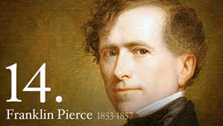
Who was elected President in the Election of 1852?
Franklin Pierce

Slide 20
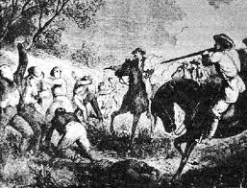
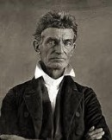
What events led to the nickname “Bleeding Kansas”?
John Brown, and six other abolitionists, killed
5 proslavery settlers in a town in Kansas. This episode resulted in an eruption of violence and bloodshed. By 1856, more than 200 people had been killed in Kansas.

Slide 21
Who was Dred Scott? How was his court case an important moment in regards to slaves?
Dred Scott was a slave who was brought by his owner into a “free” state and later returned home.
When his owner died, he filed a court case in which he argued he was a “free” man because he had once traveled to a “free” state.

Slide 22
The United States Supreme Court decided 7–2 against Scott.
The Court had ruled that African Americans had no claim to freedom or citizenship.
The Court had ruled that African Americans had no claim to freedom or citizenship, therefore, slaves were not people – they were property.

Slide 23
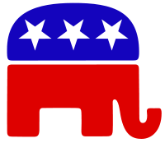
What new political party formed between the years 1854 – 1856?
The Republican Party
(Also known as the:“Grand Old Party”)

Slide 24
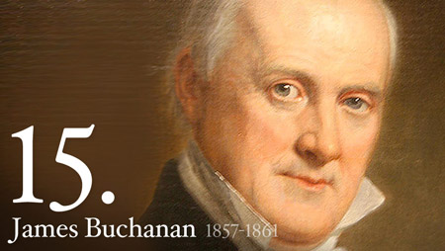
The Election of 1856
Whig Candidate - James Buchanan
Republican Candidate - John C. Freemont
Who won the election? James Buchanan

Slide 25
In 1858, who challenged Stephen Douglas for his seat in the Senate?
Stephen Douglas
Abraham Lincoln

Slide 26
What is an arsenal?
A gun warehouse

Slide 27
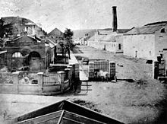
In 1859, which abolitionist led a group to Harpers Ferry, Virginia – where they raided an arsenal?
John Brown

Slide 28
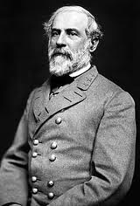
Who stopped the slave uprising from happening, by killing 10 of the raiders, and capturing
John Brown?
U.S. Army General Robert E. Lee

Slide 29
What eventually happened to John Brown?
He was hung.

Slide 30
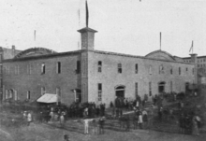
Where was the Republican Convention of 1860 held?
Chicago, Illinois

Slide 31
Who became President in the Election of 1860

Slide 32
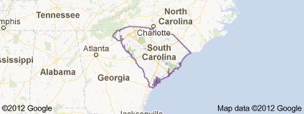
Which was the first state to secede (leave) from the Union after the Election of 1860?
South Carolina

Slide 33
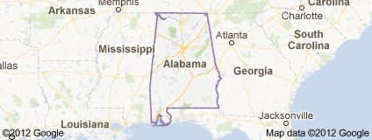
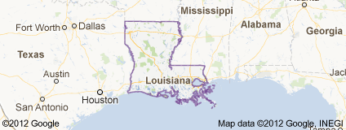
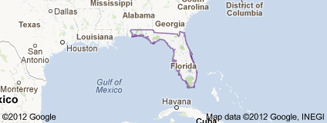
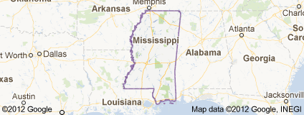
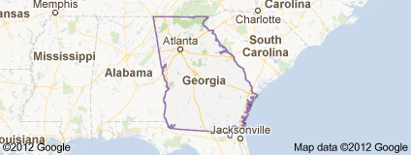
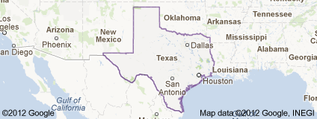
Which other states (six) seceded from the Union by 1861?
Alabama
Florida
Georgia
Louisiana
Mississippi
Texas

Slide 34
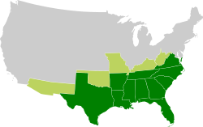
What did the 7 states that seceded from the Union call themselves?
The Confederate States of America

Slide 35
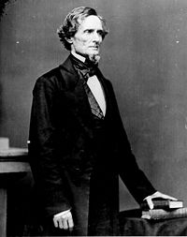
Who became the President of this new nation?
Jefferson Davis

Slide 36
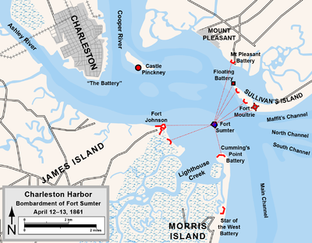
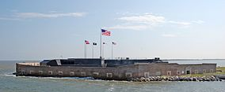
The first shots of the Civil War were fired on April 12, 1861.
Where were these first shots fired?
Fort Sumter (South Carolina)

Slide 37
Which side eventually went on to win control of this fort?
The Confederates
(After 34 hours of bombardment)

