Slide 1
Calming Procedures and strategies
Tips and Tricks

Slide 2
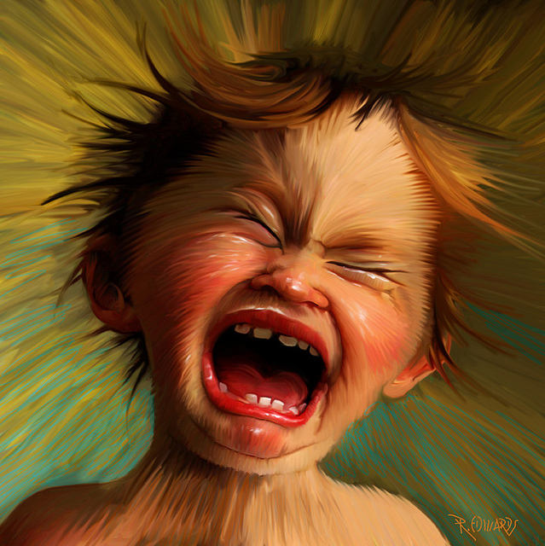
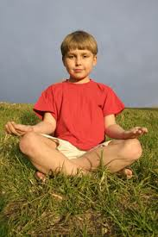
Be Proactive!
Teach “calm” at times when your child is actually calm!
“Catch” them being calm – LABEL IT! (“I like how calm your body is right now.”
Provide multiple opportunities to practice daily

Slide 3
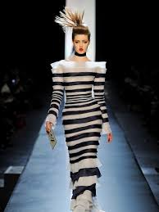
Model
NOT THAT MODEL!

Slide 4
YOU Model!

Slide 5
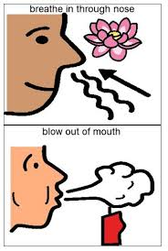
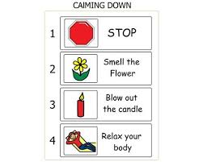
Candle Blowing/ Smell the Flower and Blow out the Candle
Place index finger in front and blow at it as if you were blowing out a candle. Move the finger back and forth to simulate a candle going out.

Slide 6
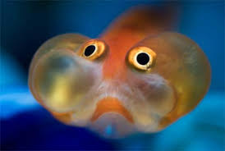
Bubble Breaths
Take a deep breath to fill your cheeks. Hold the breath for five seconds then release

Slide 7
Bumblebee Breath
Blow to make your lips produce a vibrating noise

Slide 8
Finger Wiggles
Relax hands and give them a shake to loosen up tense body muscles. Take deep breaths during this time

Slide 9
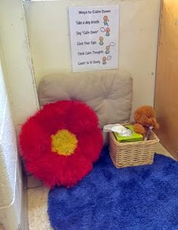
Calm Down Corner/ Chill Zone
Have an environment designated to allow for calming. Be proactive in how to teach your child HOW to use it and WHEN they need to use it.
We need to teach our children to take responsibility for their emotions.

Slide 10
During the Tantrum
Calm Counting:
WHOLE CHILD CONSULTING VIDEOS
http://www.wholechildconsulting.com/videoc.html
CALM COUNT TOOLKIT

Slide 11
During the Tantrum
1. MODEL APPROPRIATE CALMING STRATEGIES
Lower your voice even to a whisper if you have to
Take deep breaths (It will help both you and your child!)
2. MODEL APPROPRIATE LANGUAGE
Use “I” statements
Chances are you have a pretty good idea WHY your child is upset. Model language that he/she can use next time they are upset. Nonverbal? Model with their mode of communication (PECS, device, sign, etc)
Use SIMPLE language! EVERYONE has difficulty processing language when they are upset. Don’t waste time listing the 7 reasons why they can’t have TV right now. Instead, acknowledge their feelings and move on to calming strategies. Ex: I am sorry you are mad right now, but it’s not time for TV right now. It’s OK to be mad, but I can be calm. I can take deep breaths, etc
Don’t negotiate or give in! We do not want to reinforce the tantrum!

Slide 12
Resources
Whole Child Consulting
http://www.wholechildconsulting.com/index.html
Teachers Pay Teachers:
Melissa Toth
Lynn Hubbell
Sarah Hallagan
Serena Forrest
Sandbox-Learning
https://www.sandbox-learning.com
Sound-Eaze CDs
http://buzzesandbeehives.com/special-needs

