Slide 1
Using Visual Strategies

Slide 2

How did you remember to come tonight?

Slide 3
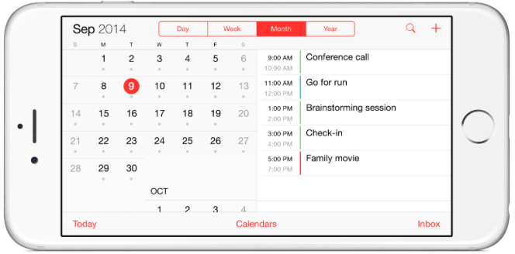

Slide 4
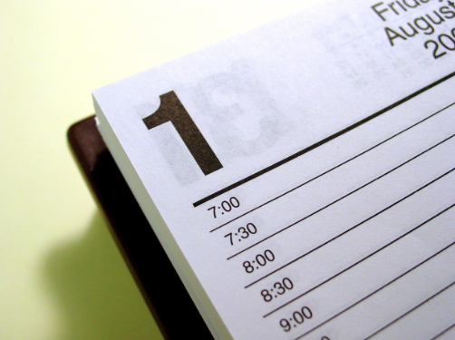

Slide 5


Slide 6
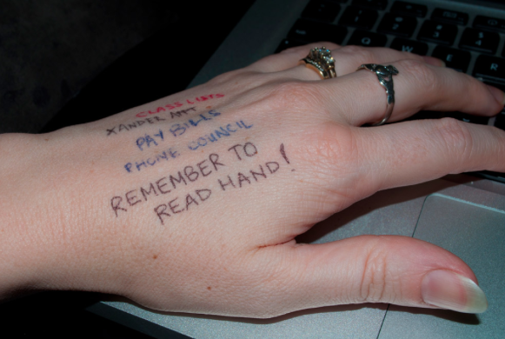

Slide 7
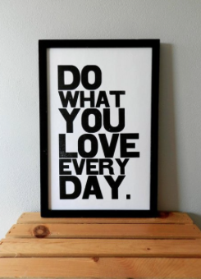

Slide 8
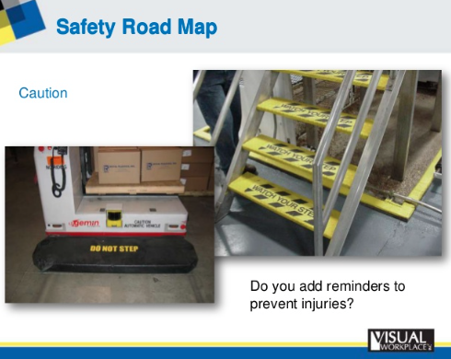

Slide 9
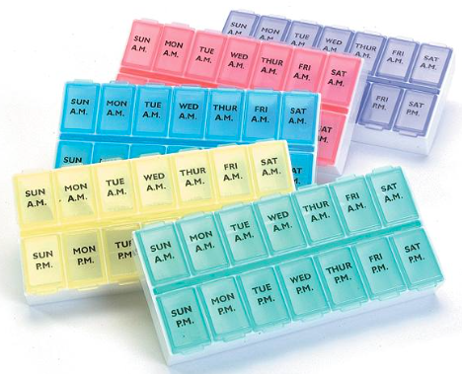

Slide 10
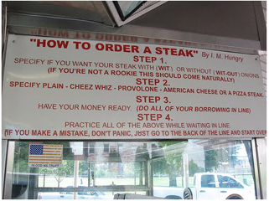

Slide 11
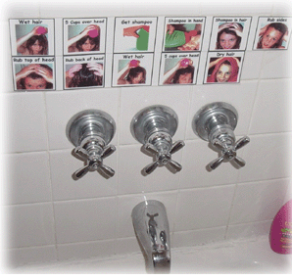

Slide 12
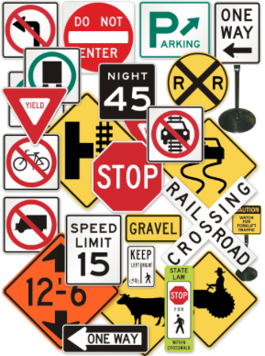

Slide 13


Slide 14
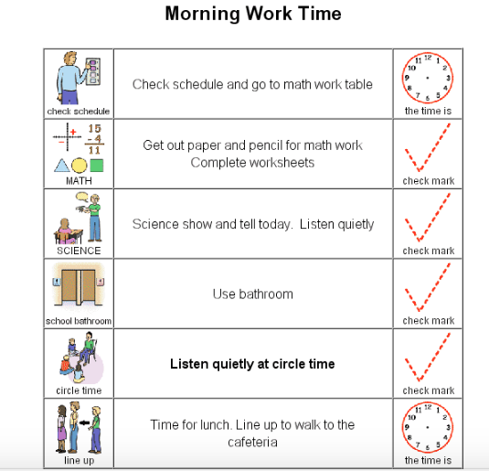

Slide 15
Chinese Proverb:
I hear and I forget.
I see and I remember.
I do and I understand.

Slide 16
25 Reasons to Use Visual Strategies - Linda Hodgdon, M.Ed., CCC-SLP
Establish attention
Give Information
Explain Social situations
Give choices
Give structure to the day
Teach routines
Organize materials in the environment
Organize space in the environment
Teach new skills
Support transitions
Stay on task

Slide 17
25 reasons continued…
Ignore disractions
Manage time
Communicate rules
Assist students in handling change
Guide self-management
Aid memory
Speed up slow thinking
Support language retrieval
Provide structure
Learn vocabulary
Communicate emotions
Clarify verbal information
Organize life information
Review and remember

Slide 18
Tools to give information
Schedules/ mini-schedules
Calendars
Choice Boards/Menus
Communicating No
People Locators
Transition and travel helpers
Help remember information
Task Organizers
Structuring the environment

Slide 19
Using Visual Supports to Solve Problem Behaviors in the Home Information from Linda Hodgdon’s book “Solving Behavior Problems in Autism”

Slide 20
Behaviors Communicate
All behaviors are a form of communication
Behaviors have 2 main functions:
To get something (obtain)
To get out of something (escape)

Slide 21
What do you call behavior problems?
A broad definition:
When a child is NOT doing what I want him/her to be doing
When a child is doing something I DON’T want him/her to be doing

Slide 22
The Behavior Continuum
Annoying habits
Things I want changed
Really annoying behaviors
Behaviors that are causing problems
Behaviors I can’t stand anymore
Behaviors that are preventing life routines
Behaviors preventing learning
Behaviors causing injury or destruction

Slide 23
The Environment
A child’s behavior may change in different places for different reasons
Structured home vs. out in the community (more relaxed)
Some issues
Sensory
Physical space
Who is there
Location of temtations

Slide 24
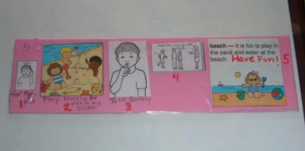
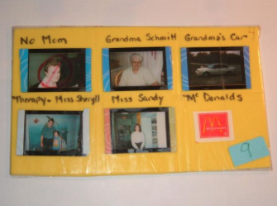
Why use visuals??
Words disappear
Help prepare for what comes next (anxiety)
Provide structure for appropriate behavior and participation
Tells them what is not going to happen
Gives choices and help teach the power of language

Slide 25
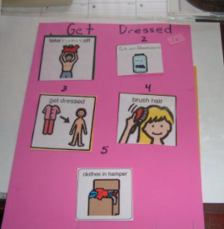
So what do we do??
When the predictable routines of life change, children with communication difficulties have more problems
Develop a lifestyle of familiar schedules and routines

Slide 26
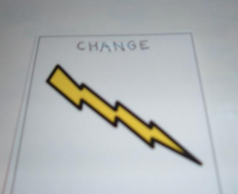
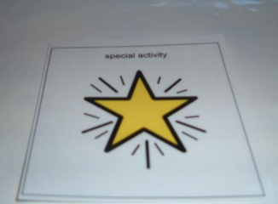
Use visuals to show change
Use a visual to show change – always use the same symbol.
Ex: no park, watch movie (on a rainy day). Incorporate this into the schedule as you know there will be a change
Special Activity symbol – we will go to the movies today

Slide 27
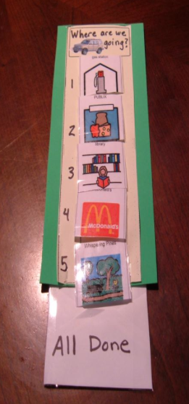
Where are we going?
A simple visual to show a child wehre they are going once they are in the car.
Lessens anxiety/ tantrums
If there is a change, use the symbol
Keep extra symbols on the back

Slide 28
Sooooo Simple to Make
Clip Art on the computer, or photos, flyers, etc
Mailing tape (takes the place of laminating), foam envelope, permanent marker, velcro and stapler

Slide 29
Understanding
Communicate information in a form that the child can understand easily, especially when upset…. Words disappear

Slide 30
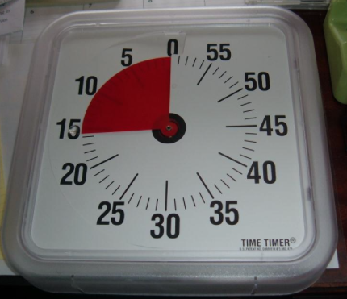
Visual Timer
A wonderful visual tool to SHOW “how much longer” or “how long until.” This can be used for “waiting”, “time out”, “how long do I do my math work?”, “I can play for the amount of time on computer”, etc.
Helps eliminate anxiety and meltdowns

Slide 31

No Sign
The NO sign is very important to teach SAFETY, put on doors, front of stove, etc
It is very concrete
Shows them what not to do. Can be paired with a visual of what to do instead: “no hitting, soft touch (with visual)

Slide 32
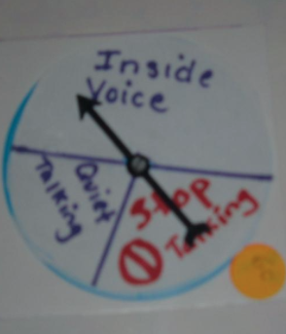
Voice Level Reminder
Create your own voice level reminder from an old game spinner
Helps a child remember to use an “inside voice” when they are excited and having fun, make it positive

Slide 33
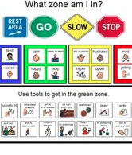
Behavior Method
Try to use the same method at home that is being used in school
This reinforces the understanding of the method and everyone is on the same page
Makes an abstract method concrete
Use positive reinforcers for positive behavior
Overemphasize good behavior, then you will see more of it

Slide 34
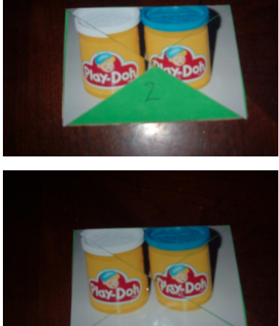
Positive Reinforcer for good behavior
Take a photo of a favorite activity and let your child earn it piece by piece. They will se it forming with each good behavior they exhibit
Completing the visual helps reinforce the good behavior

Slide 35
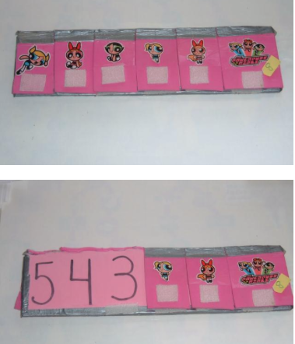
Transition Tool
Use their favorite color and add stickers they like to motivate them to look at it.
First they see it – helps prepare them for a change
Begin counting, go slowly and be ready to go on the last section

Slide 36
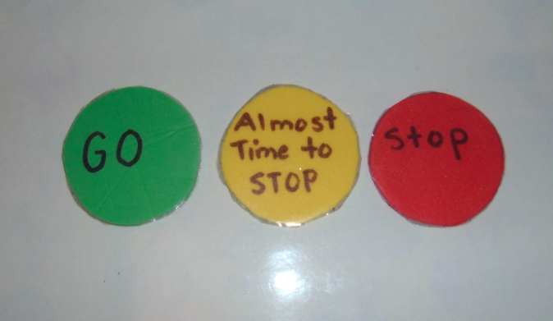
Another Simple Transition Tool

Slide 37
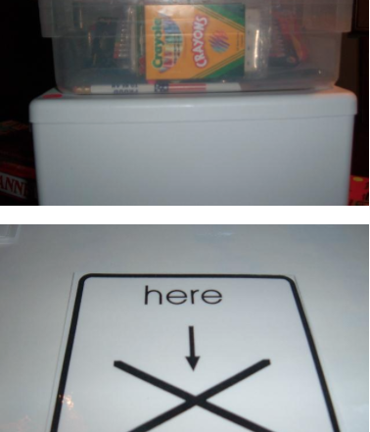
Organize
Use visuals to teach your child where to put their personal items in their room, so they can comply with putting things in their place
Use visual to show them where to sit at the table, or where to put their toys
This can be used to put papers from school or schoolwork to be checked

Slide 38
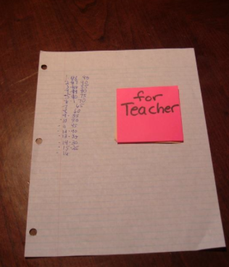
Color Coded Post it Note
Use a certain colored post it note for papers to go to the teacher
Ask the teacher to do the same for papers to go to parents using a different color
Helps organize your child
Folers and bins are also helpful

Slide 39
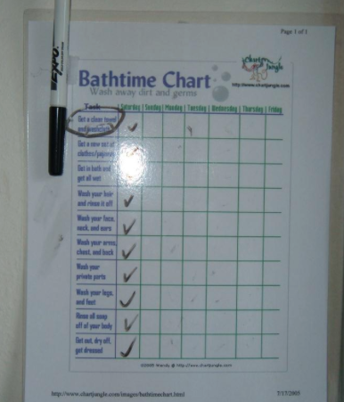
To Organize
Use visuals to organize and promote independence and responsibility
Organize a bath routine, and all good hygiene routines
This will help promote the need and ability to have privacy when it is needed

Slide 40
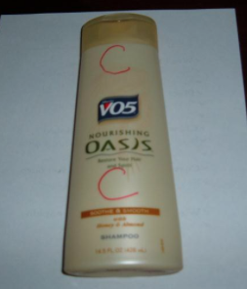
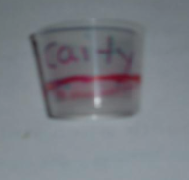
Bathtime
As your child gets older, prevent them from using an entire bottle of shampoo in just 3 days, or using conditioner on their head instead of shampoo
Helps promote independence and allows them to bathe without assistance as they get older

Slide 41
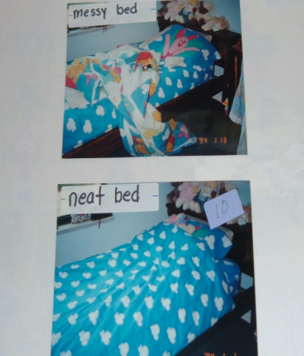
Take away the abstract
Instead of saying “clean your room”, SHOW the visual of what clean actually means in that environment. The word “clean” may not mean anything to that child, or something entirely different than your definition

Slide 42
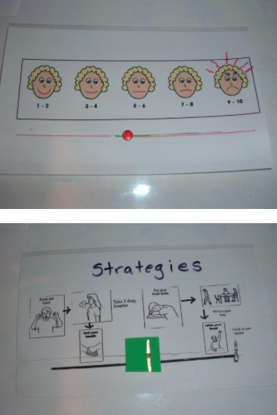
Regulate Emotion
Teach your child how to recognize their emotions and then hot to use them to keep them from escalating.
Use this visual BEFORE a behavior escalates further, while they still have some control and can use the strategies

Slide 43
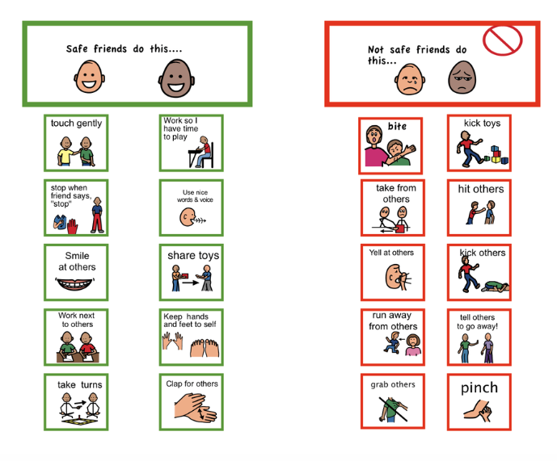

Slide 44
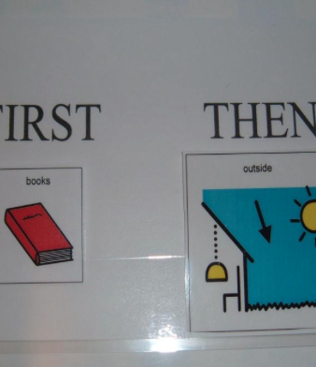
FIRST and THEN
Your child must first understand the concept of first and then
This can be used to get them to do an undesired activity first and then reward them with a desired activity, or just explain what is happening FIRST.

Slide 45
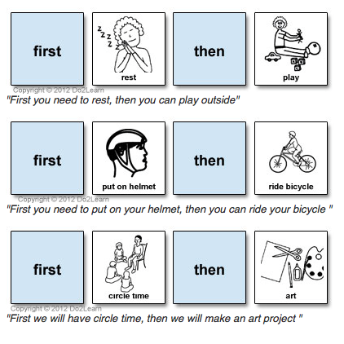

Slide 46
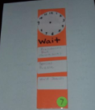

Waiting
Very difficult, abstract concept for a child to learn.
Hand them a visual of waiting while at the traffic light, while in line, at the doctor, when they are upset. It will show them what to do while waiting.
They will SEE the visual and know it is time to wait. Make sure they have simple available choices with you.

Slide 47
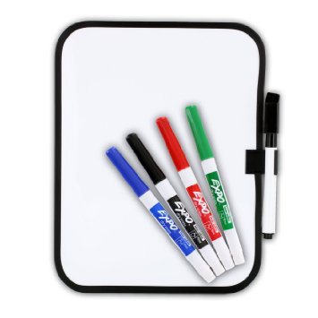
MY FAVORITE TOOL

Slide 48
Books/Resources
“Solving Behavior Problems in Autism” by Linda Hodgdon
“Visual Strategies for Improving Communication” by Linda Hodgdon
“Taking Care of Myself” by Mary Wrobel, A Healthy Hygiene, Puberty and Personal Curriculum for Young People with Autism
www.chartjungle.com for bath time charts, etc.
http://www.dltk-cards.com

Slide 49
References and Resources
http://usevisualstrategies.com/visual-tools-for-autism/
http://www.visualaidsforlearning.com
http://do2learn.com/picturecards/overview.htm
http://www.citrus.k12.fl.us/ese/Powerpoint/Using%20Visual%20Supports%20to%20Solve%20Problem%20Behaviors%20in.pdf

